Slide 1
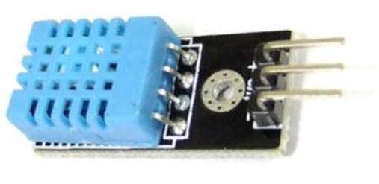
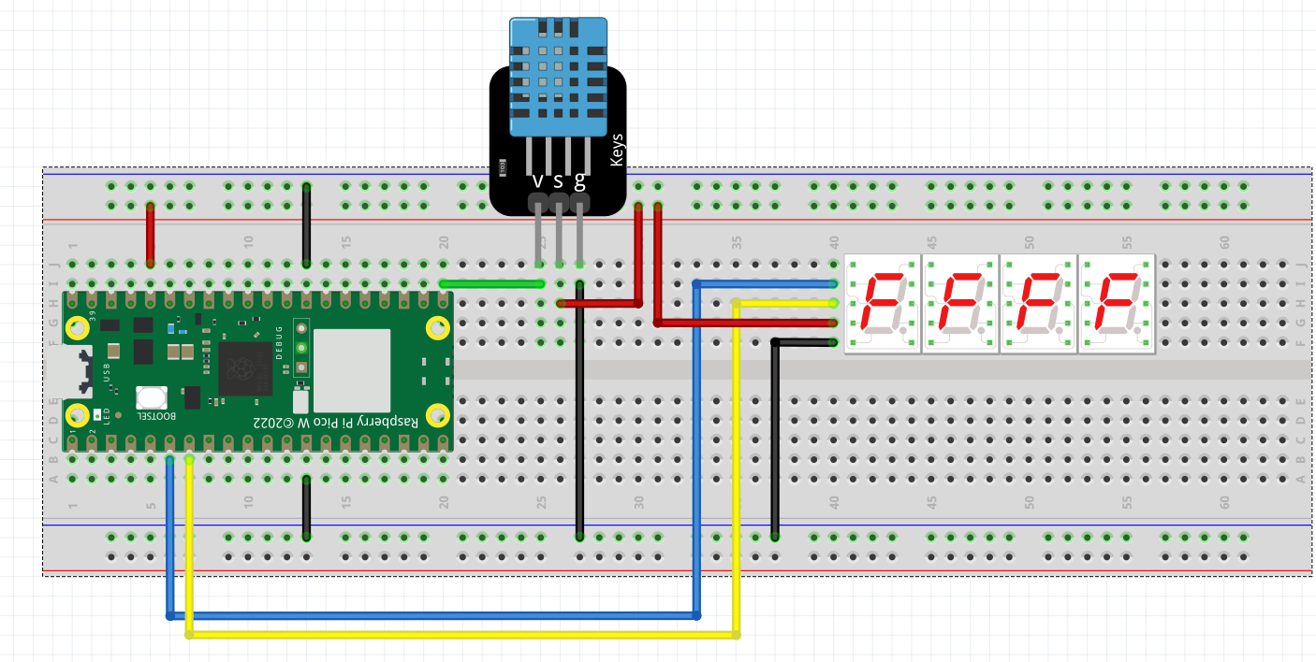

THE DHT11 TEMP/HUMIDITY SENSOR
S
_
S
_

Slide 2
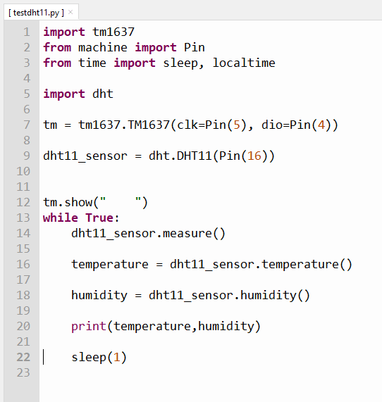
SAMPLE CODE
The library for the dht sensors comes pre-installed in the firmware.
Hence there’s no need to download it (unlike the tm1637 display)
This is how to set it up. According to the wiring
Diagram it is hooked up to Pin 16. In this program The name assigned
to this sensor is dht11_sensor. You can choose whatever name you wish.
This line of code will fetch the temperature/humidity data
from the sensor
Temperature and humidity data will be printed in the shell.
To view data as graph. Click View and then Click Plotter.
Hint: Use a hair dryer to simulate temperature changes. ☺
There must be an interval between readings – called sampling time. If there is no interval, an error will occur.

Slide 3
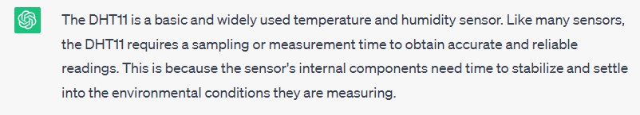
Why an interval or sampling time in between reading is needed

Slide 4
This is Ex 3.
Get the temperature and humidity reading from the dht11 sensor
And display it on the 7 segment display.
Give an interval of 2 seconds between the temperature and humidity display.
tm.temperature(25) will display 25
tm.number(80) will display 80

